Slide 1



Journey PPT
Tanishqa Aggarwal
12 Sep 2023 - 15 Sep 2023
Week 4

Slide 2

Day 1
12 Sep 2023
Azure Synapse
Azure Synapse Analytics, formerly known as SQL Data Warehouse, is a cloud-based analytics service provided by Microsoft Azure. It is designed for enterprises to analyze and gain insights from their large volumes of data. Azure Synapse Analytics offers a unified and integrated environment for data storage, big data analytics, data warehousing, and data integration.

Slide 3

Day 1
12 Sep 2023
When to use synapse
Need for a manage service
Large datasets and complex query
Manage structured and unstructured datasets
data pipeline orchestration
Analytics on real time operational data
To integrate all Microsoft azure services
Serverless SQL code
Paid as you go model
Dedicated SQL pool
Dedicated compute resources which allow you to control and optimize performance using DWU ( Dataware housing unit)

Slide 4
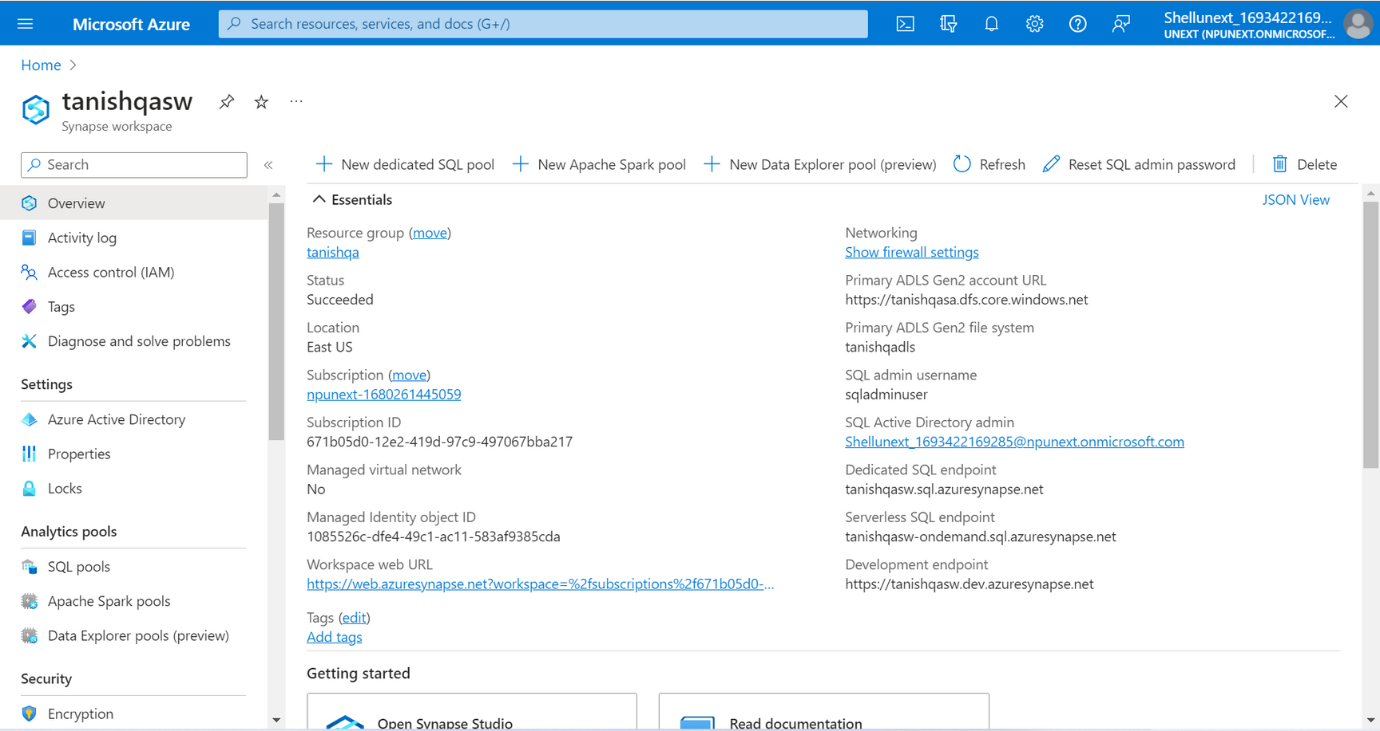
Day 1
12 Sep 2023
Azure Synapse
Azure Synapse Workplace

Slide 5
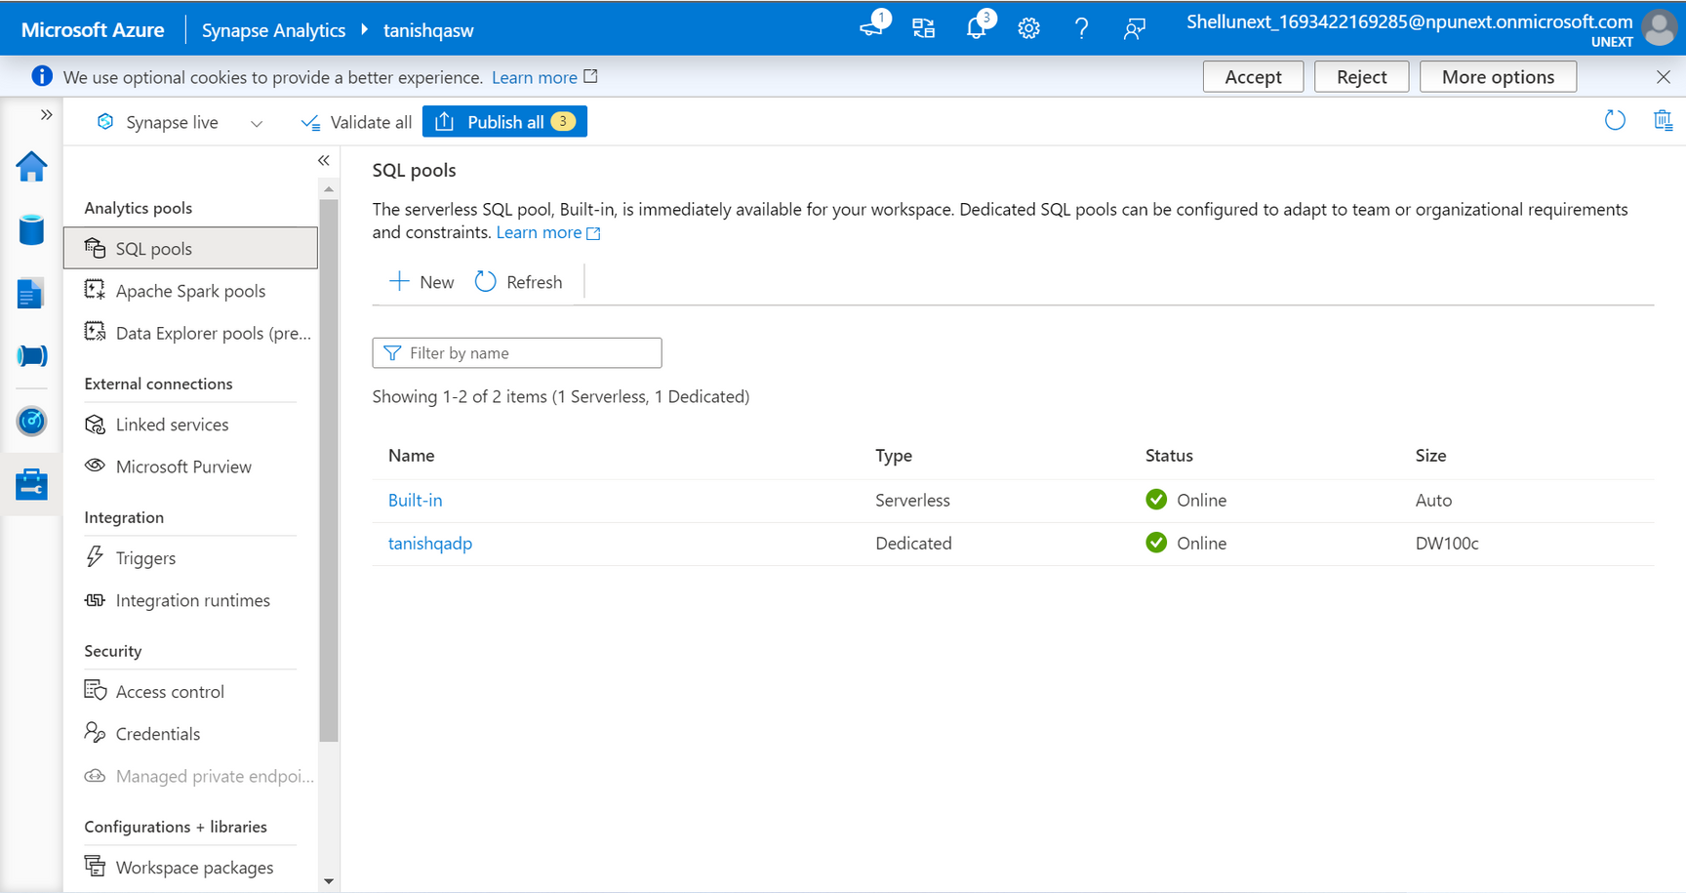
Day 1
12 Sep 2023
Azure Synapse
Azure Synapse SQL Pools

Slide 6
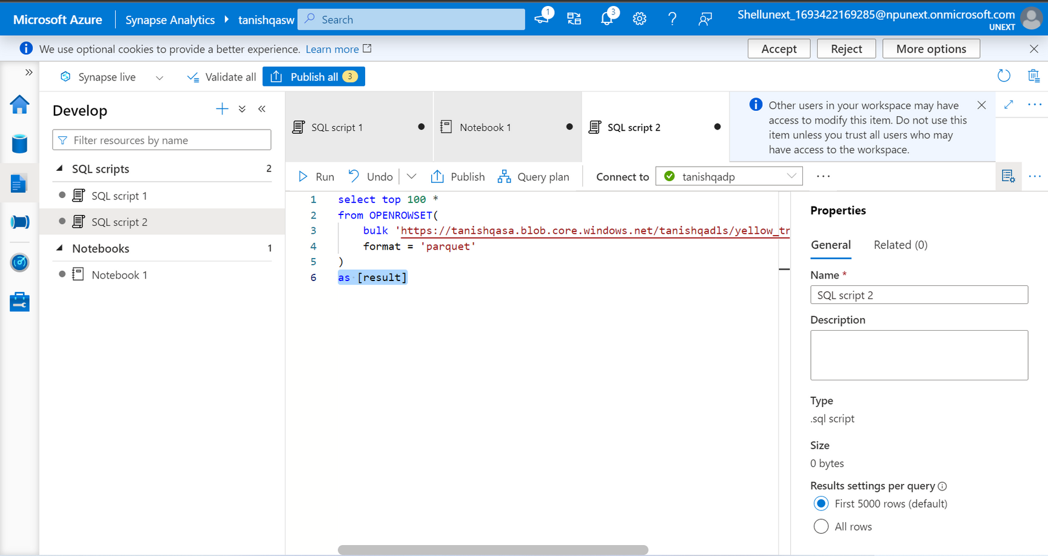
Day 1
12 Sep 2023
Azure Synapse
Executing queries in SQL editor

Slide 7
Day 2
13 Sep 2023
Data Visualisation - Power BI
Power BI is a business analytics service and suite of tools provided by Microsoft that allows users to connect to various data sources, transform data, create interactive reports, and share insights. Power BI is designed to help organizations make data-driven decisions and gain valuable insights from their data.

Slide 8
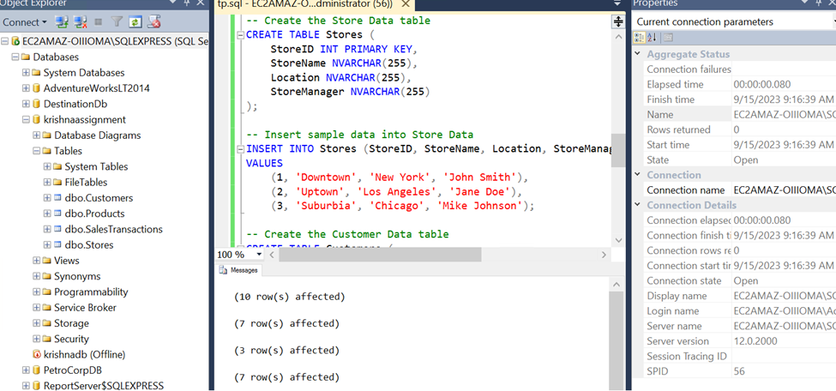
Day 2
13 Sep 2023
Power BI
Creating SQL Server

Slide 9
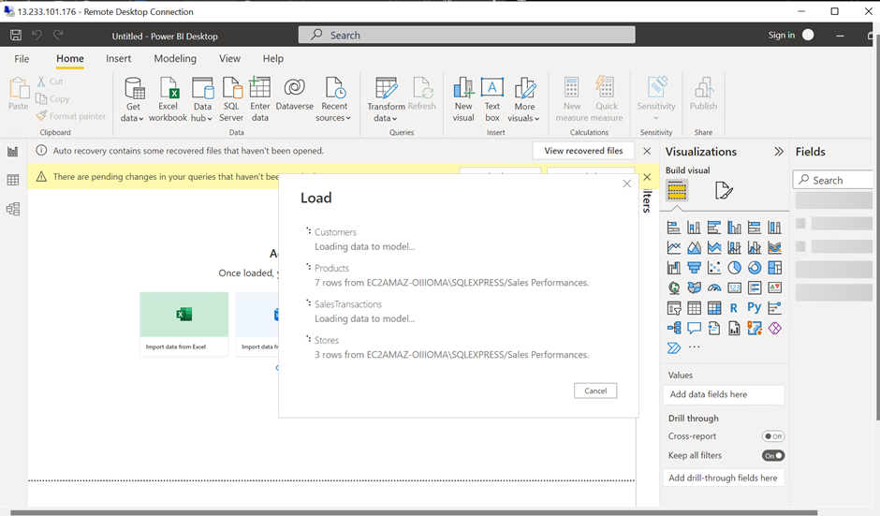
Day 2
13 Sep 2023
Power BI
Power BI desktop

Slide 10
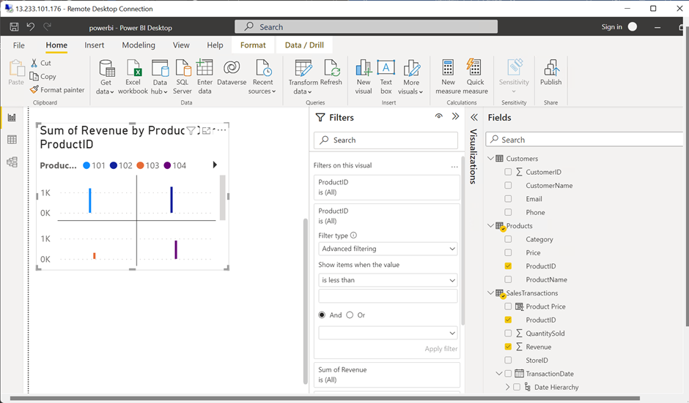
Day 3
14 Sep 2023
Power BI
Visualizing in Power BI

Slide 11
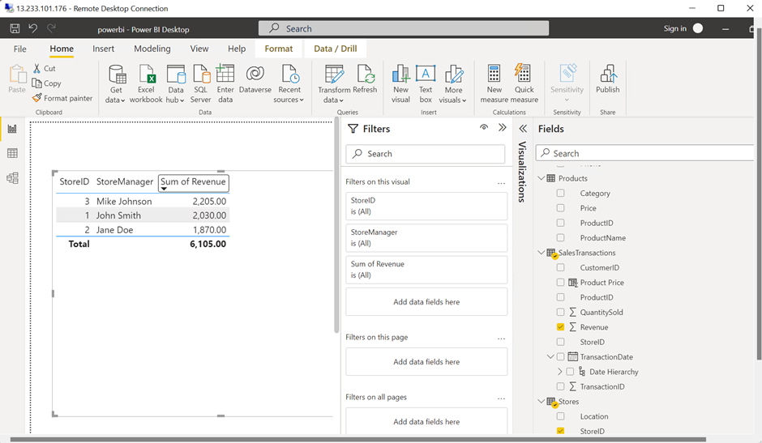
Day 3
14 Sep 2023
Power BI
Filters in Power BI

Slide 12
Day 4
15 Sep 2023
Hands-on Assessment
Scenario
Sales Performance Analysis with Power BI
Requirement 1: Data Loading
Requirement 2: Data Transformation
Requirement 3: Data Modelling
Requirement 4: Business Queries and Analysis
Requirement 5: Data Insights and Recommendations

Slide 13

Thank You

